Slide 1


Data Science &
Azure Machine Learning
For Beginners

Slide 2
Introduction to Data Science
Notes:
- Demo bot > cognitive > luis

Slide 3
The opportunity is bigger than you may think
Diverse data
$1.6T
New analytics
@
How?
Speed
data dividend available
to businesses that embrace
data over the next four years
More people
Data source: Microsoft and IDC, April 2014
Notes:
Key Points:
Companies that make best use of data and analytics investments stand to capture more value compared to companies that do not
Data is the new currency—the formula is relatively simple as to how we get our returns on data
Talk Track:
If data is the new competitive advantage for business, we want to get granular and specific on how companies can derive business value.
IDC explored the impact of data on business. After surveying more than 2,000 companies, IDC found that there are two categories of businesses: organizations that have taken a leadership position when it comes to data; and those that are not making best use of data. We learned that the leaders—those companies that embraced data—derived significantly more dividends from those investments in data—from increased revenue, improved productivity, and reduced costs.
There is a unique formula that drives this notion of data dividends, or return on data. Data-driven companies focus on several areas:
Capturing diverse data: You can no longer just think about what to do with traditional data types. You need to be open to and capable of collecting a wide array of data—including new data types.
Utilize new analytics: Logical data warehouses are no longer going to extract and transform new data types. You need to explore new analytical capabilities that are suited to new data types and real-time decision making needs.
Deliver to more people: To unlock insights, you need to democratize your data across the organization.
Uncover real-time insights: With the rise of the Internet of Things, and the instrumentation of just about everything, the ability to provide real-time visibility across lines of business represents a big value opportunity.
At the worldwide level, leaders will capture $1.6 trillion more in value from their data and analytics investments over the next four years compared to companies that don’t. This represents a 6 percent higher data dividend for leaders—an opportunity that exists for any individual organization looking to maximize its return on data assets and reap ongoing data dividends.
This means that data really is a new currency of the twenty-first century business economy.

Slide 4

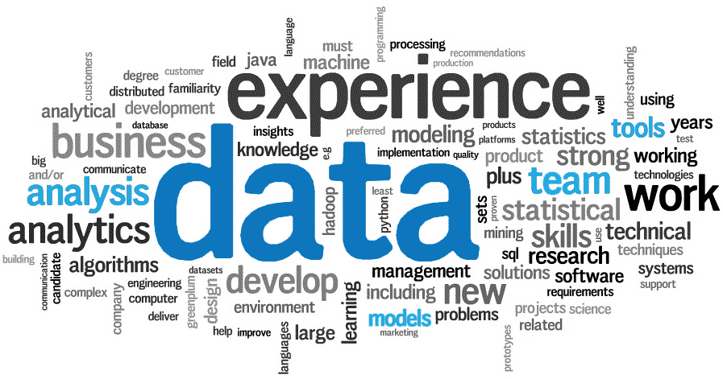
Data Science
The study of data to extract actionable insights and relevant information
Notes:
Data is the new oil
With so much data and big data out there, we need a way to understand the data
Data science is the study of how we can analyze these huge amounts of data using algorithms
Visualization of data helps us to ingest what is important in the data

Slide 5

[main] How does it work?
Algorithm = Recipe
Data = Ingredients
Computer = Blender
Answer = Smoothie

Slide 6
[main] 5 questions data science can answer
Is this A or B?
Is this weird?
How much or how many?
How is this organized?
What should I do next?
Notes:
- On a very high level, machine learning and data science answers these core questions

Slide 7
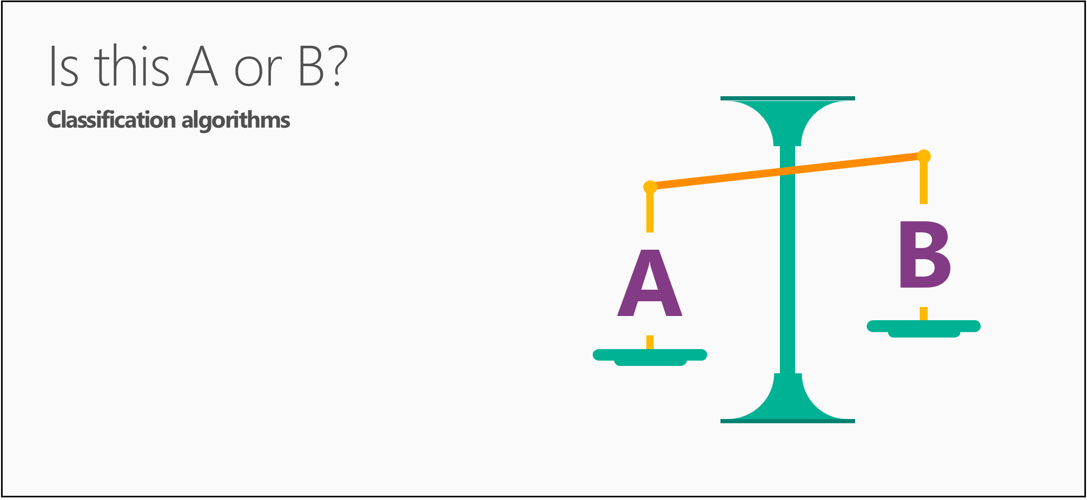
Will this tire fail in the next 1,000 miles: Yes or no?
Which brings in more customers: a $5 coupon or a 25% discount?

Slide 8

If you have a car with pressure gauges, you might want to know: Is this pressure gauge reading normal?
If you're monitoring the internet, you’d want to know: Is this message from the internet typical?

Slide 9
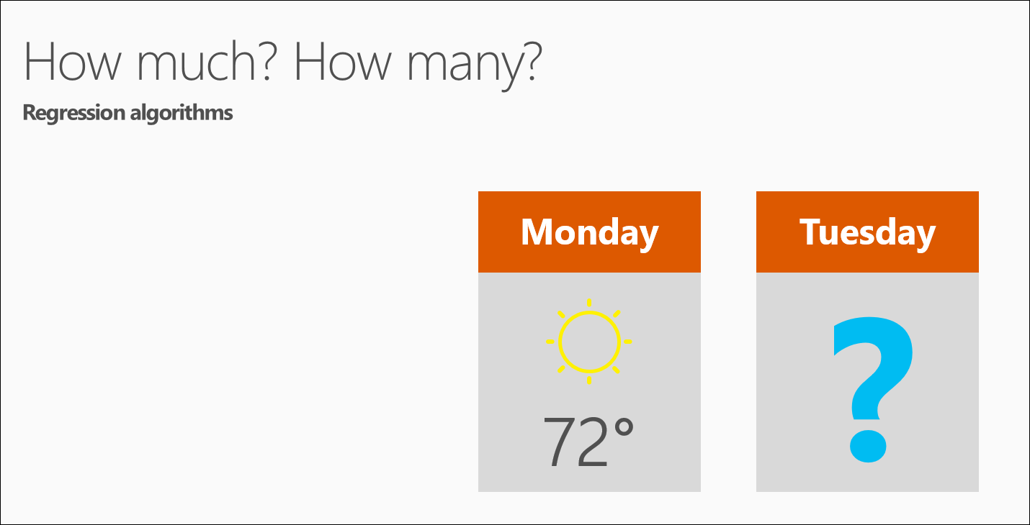
What will the temperature be next Tuesday?
What will my fourth quarter sales be?

Slide 10
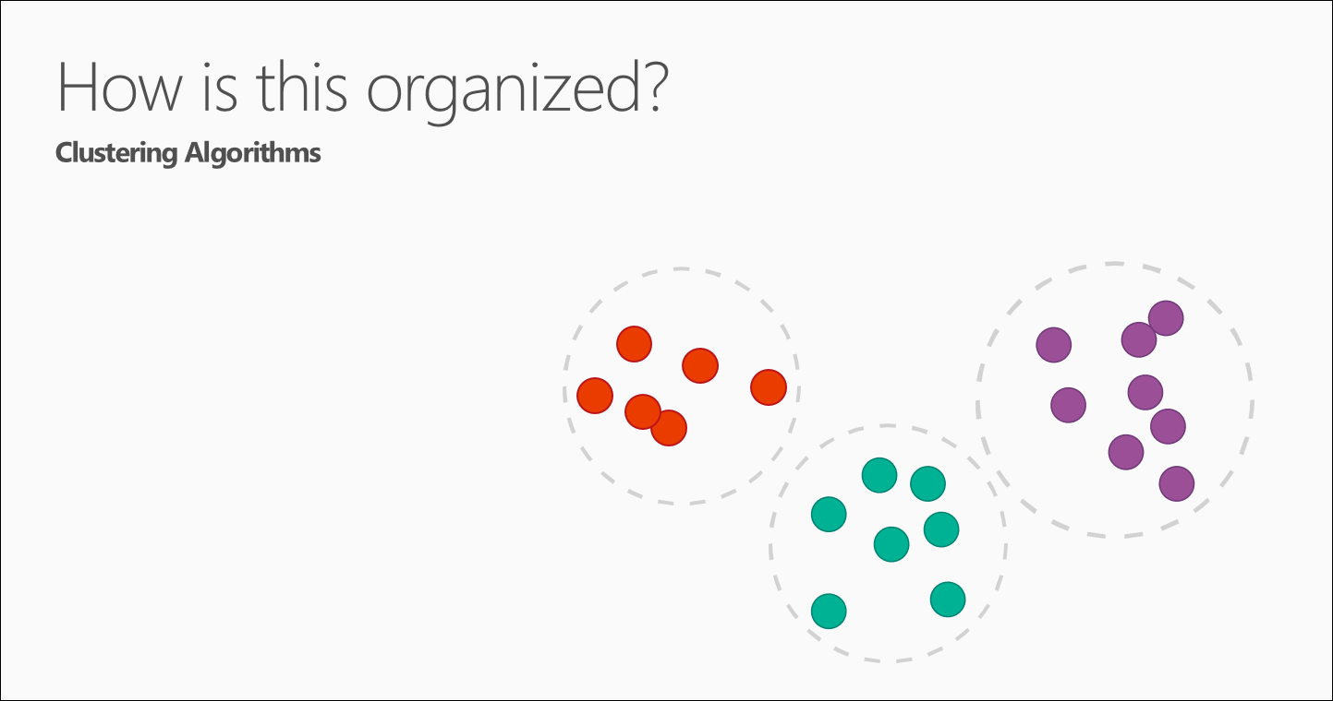
Which viewers like the same types of movies?
Which printer models fail the same way?

Slide 11
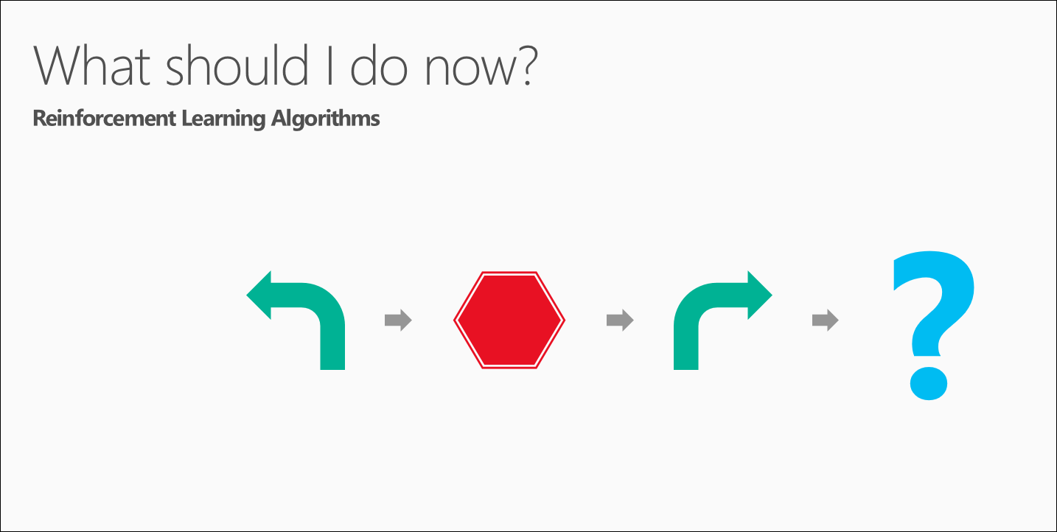
If I'm a self-driving car: At a yellow light, brake or accelerate?
For a robot vacuum: Keep vacuuming, or go back to the charging station?

Slide 12

[main] Is your data ready?
Data needs to be:
- Relevant
- Connected
- Accurate
- Enough to work with
If you don’t have the right ingredients, you won’t make the right dish

Slide 13
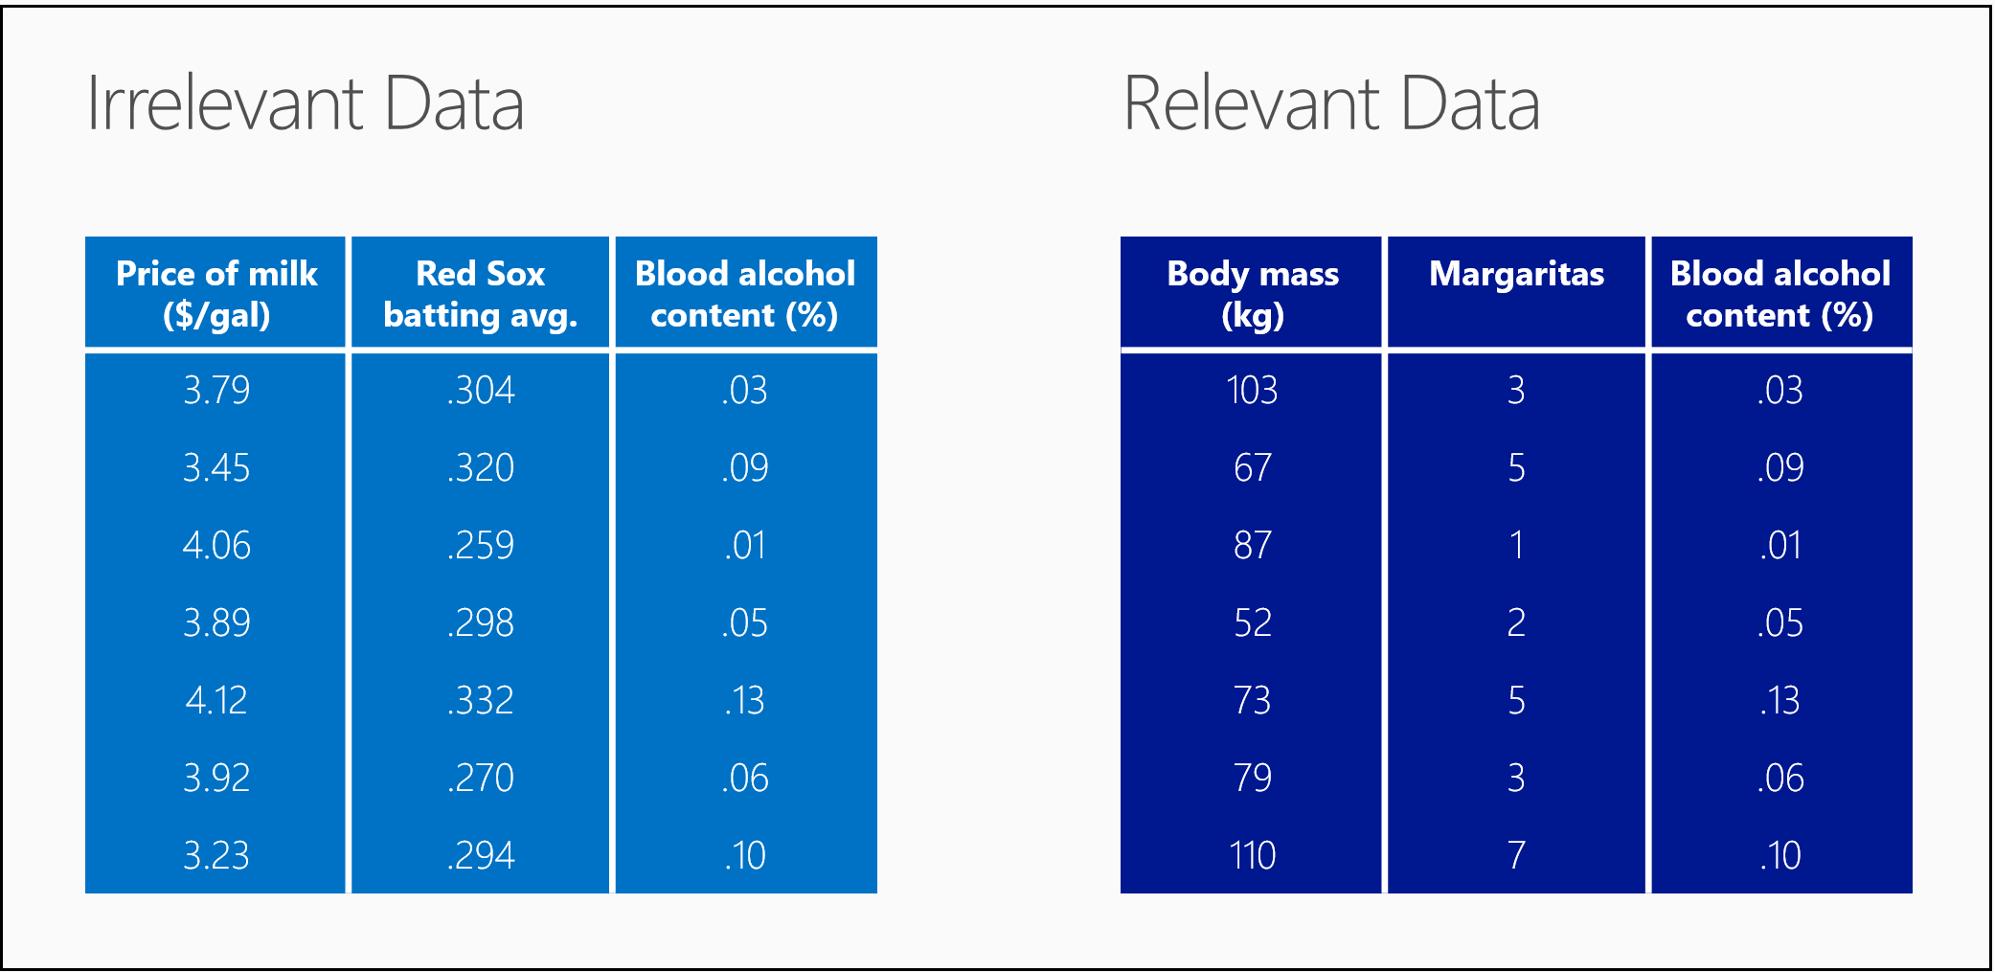

Slide 14
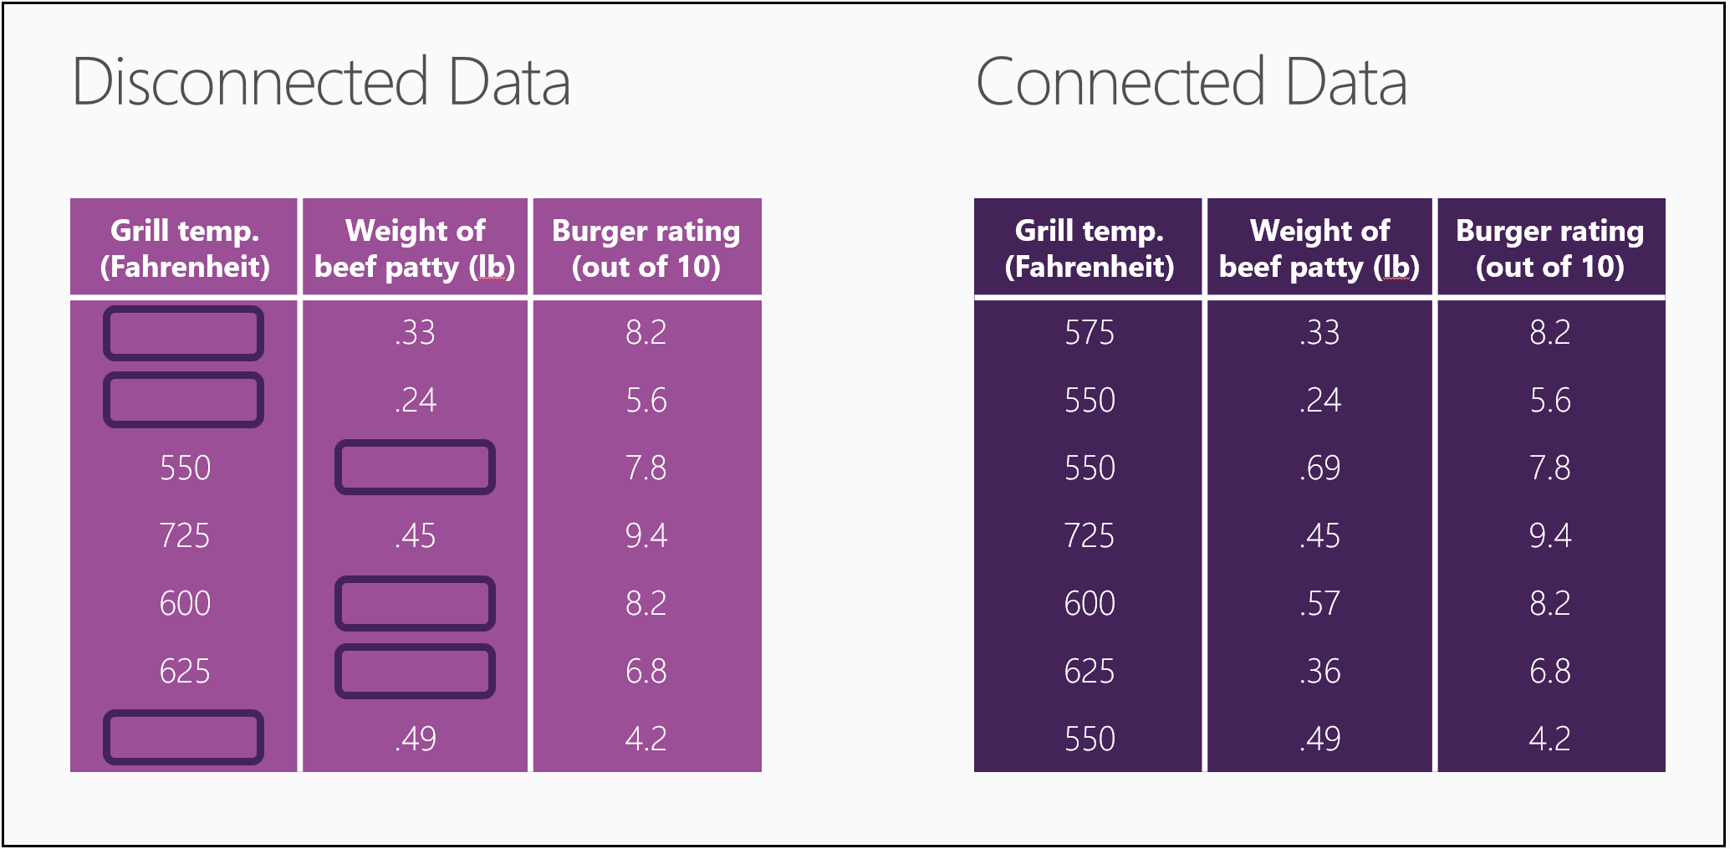

Slide 15
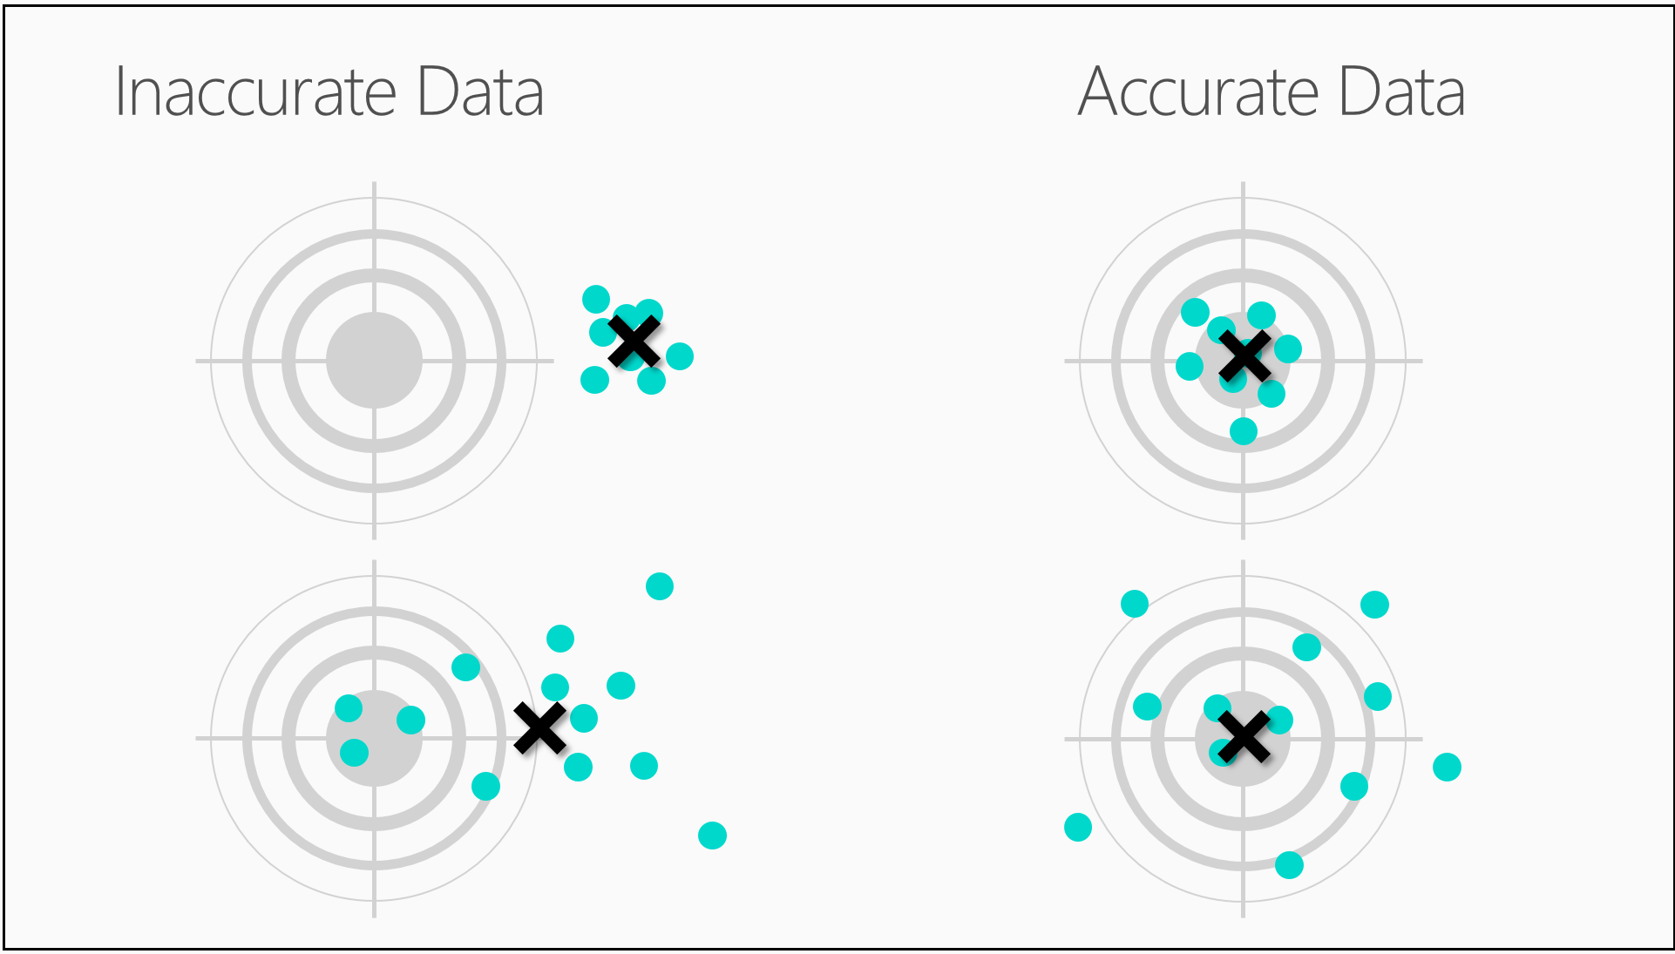

Slide 16


Slide 17
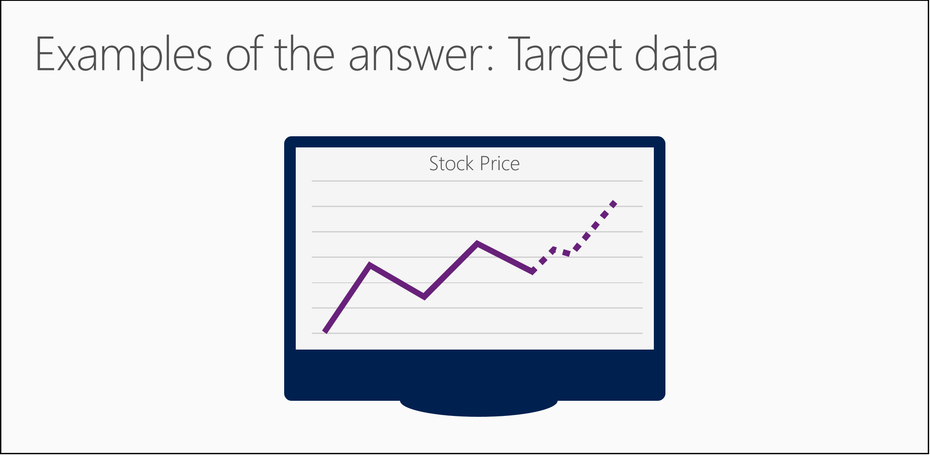
Notes:
You need examples of the answer in order to predict the next answer.
If we don’t have the relevant data, we won’t be able to predict what we want.

Slide 18

[main] Asking the right questions
Ask a sharp question
The right parameters will give you the right answer
Notes:
Imagine you found a magic lamp with a genie who will truthfully answer any question you ask.
But it's a mischievous genie, and he'll try to make his answer as vague and confusing as he can get away with.
You want to pin him down with a question so airtight that he can't help but tell you what you want to know.
If you were to ask a vague question, like "What's going to happen with my stock?", the genie might answer, "The price will change".
That's a truthful answer, but it's not very helpful.
But if you were to ask a sharp question, like "What will my stock's sale price be next week?", the genie can't help but give you a specific answer and predict a sale price.

Slide 19
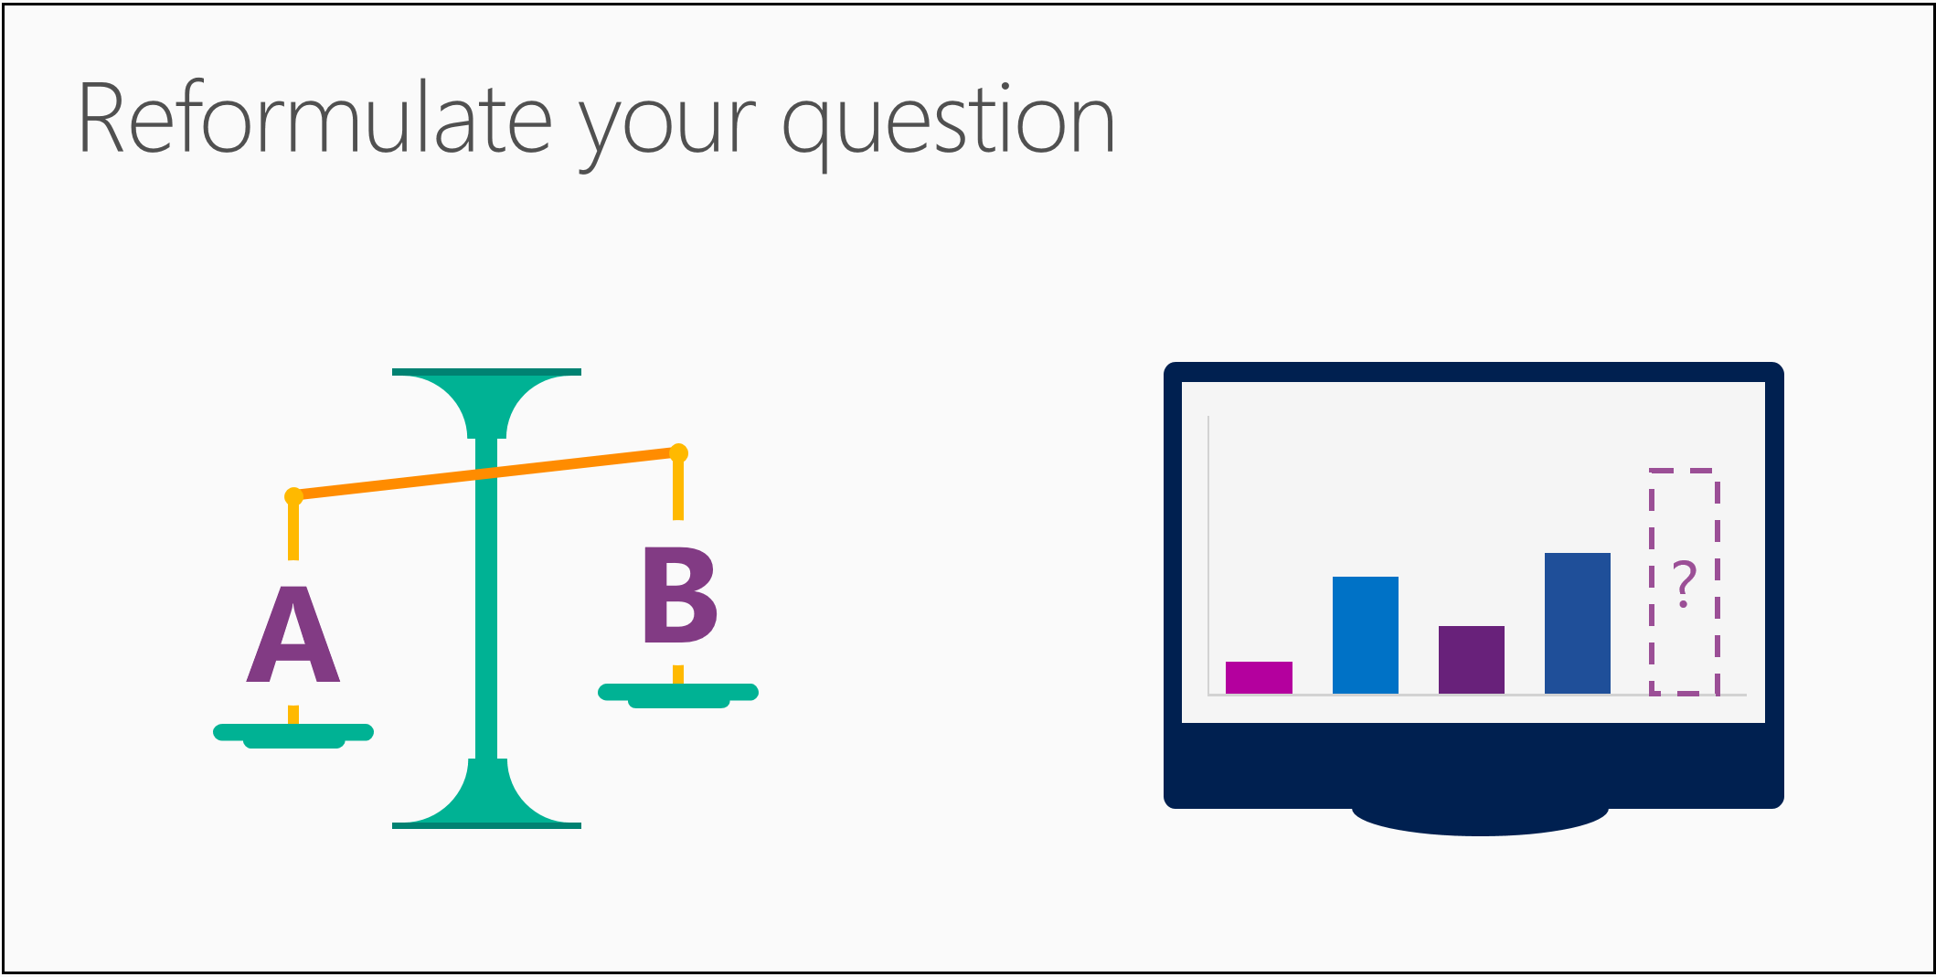
Notes:
To see how we can transform these, let's look at the question, "Which news story is the most interesting to this reader?" It asks for a prediction of a single choice from many possibilities - in other words "Is this A or B or C or D?" - and would use a classification algorithm.
But, this question may be easier to answer if you reword it as "How interesting is each story on this list to this reader?" Now you can give each article a numerical score, and then it's easy to identify the highest-scoring article. This is a rephrasing of the classification question into a regression question or How much?
You'll find that certain families of algorithms - like the ones in our news story example - are closely related. You can reformulate your question to use the algorithm that gives you the most useful answer.

Slide 20
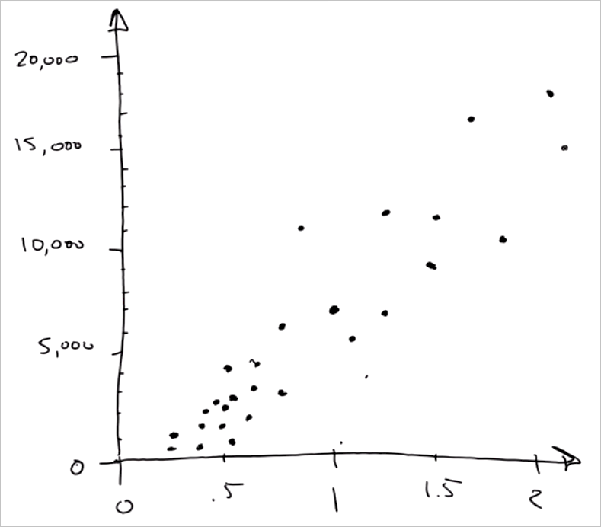
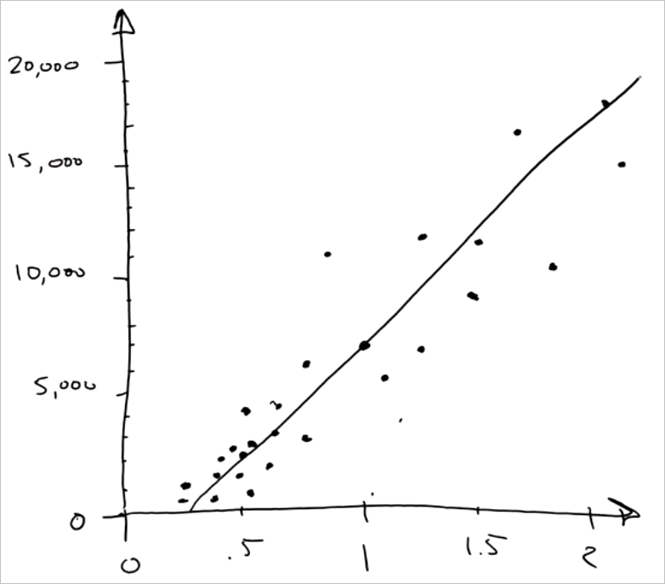
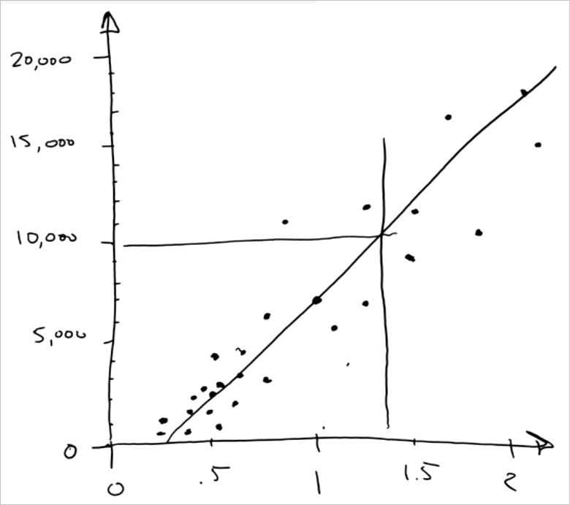
Simple algorithm – Linear regression

Slide 21
Introduction to Azure ML
Notes:
- Demo bot > cognitive > luis

Slide 22
What is
Machine Learning?
Computing systems
that become smarter
with experience
“Experience” =
past data + human input
“
I need our systems to think.
I need them to learn and
I need them to present issues
and problems and anomalies
to the employees, to the managers.
Adam Coffey
President and CEO
WASH Laundry Systems
”
Notes:
Machine Learning is a term that is not widely understood, perhaps you think of it as artificial intelligence or robotics or any number of things. It’s helpful to start with how Microsoft thinks of machine learning. Machine learning means computers that become smarter with experience. What do we mean by experience?
Experience is past data + human input. And that past data is often huge – the quantity of data is doubling about every 18 months and that’s only increasing from here. Computers can consider far more variables than a human making the same decision.
And what do we mean by human input? Human input takes two forms – the input of the user who is either communicating that the output is what they are looking to see or not. In the case that it’s not, the machine can either self-adjust to deliver better results moving forward or the advanced analytic developer or data scientist can make those changes to the model. Let’s look at examples from our own work over many years.
WASH video:
https://www.youtube.com/watch?v=iIYU1Xfhr8g&feature=youtu.be

Slide 23
Microsoft & Machine Learning
Answering questions with experience
1991
1997
2008
2009
2010
2014
2015
Microsoft Research formed
Hotmail launches
Which email is junk?
Bing maps
launches
What’s the best way home?
Bing search launches
Which searches are most relevant?
Kinect launches
What does that motion “mean”?
Skype Translator launches
What is that person saying?
Azure Machine Learning GA
What will happen next?
Machine learning is pervasive throughout Microsoft products.
Notes:
Microsoft has been working on machine learning for over two decades. We formed Microsoft research back in 1991 to tackle the tough problems internally that we’re enabling you to tackle yourselves today.
When we think of learning from experience – past data + human input – a great example is Hotmail. Back in 1997, external email was a relatively new concept. There wasn’t a lot to go on in terms of what email the customer wants and what they do not. With the rise of email, also came spam – and lots of it. Some of those issues were easy – like Nigerian princes we learned pretty quickly don’t give away their fortunes to strangers. But what about “free offer” – maybe that free offer is something the customer always wanted. Maybe it’s something they’d never want. But that’s where the “human input” part comes in as data is being collected – that takes the form of the actual user of the email service saying “yes, this is junk” or “no, I want this” and then the data scientist learning in aggregate and making tweaks to the underlying model in response.
And we kept going with that learning – relying on past data and human input to solve problems like the best way home, which search results are most meaningful to the user and one of the toughest ones to tackle with Kinect. Kinect’s past data was all in the lab – we didn’t have a product in market that captured user input and translated that to active game play so we had to make up the variables. But that only takes us so far. The researchers told me that one thing they didn’t consider was people answering the phone while playing. This happens a lot – and Kinect at first was translating this as a wild motion in the game play – essentially crashing people’s cars or any number of unintended consequences. That was the human input we rely on, which allowed us to learn quickly and adjust the underlying model to ensure that answering the phone would not be considered part of the game moving forward.
Skype translator is another huge machine learning problem to solve if you think of all the ways a person who is speaking English can pronounce the same word – tom-A-to or tom-AH-to – that’s the same word in French so Skype has to adjust quickly to ensure all the millions of variables are considered.
But what about using all this learning to predict what’s next? Many of the same algorithms running behind the scenes of our products in market today are available within Azure ML, allowing you to take your own past data and learn from it what will happen in the future for your business.

Slide 24




What can Azure ML do for you…?
Telemetry data analysis
Buyer propensity models
Social network analysis
Predictive maintenance
Web app optimization
Churn analysis
Natural resource exploration
Weather forecasting
Healthcare outcomes
Fraud
detection
Life sciences research
Targeted advertising
Network intrusion detection
Smart meter monitoring

Slide 25

Microsoft Azure Machine Learning
Make machine learning accessible to every enterprise, data scientist, developer, information worker, consumer, and device anywhere in the world.

Slide 26

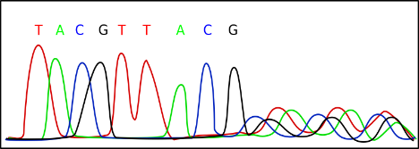
Why?
Data Science is complex
  Cost of accessing/using efficient ML algorithms is high
  Comprehensive knowledge required on different tools/platforms to develop a complete ML project
  Difficult to put the developed solution into a scalable production stage
Azure Machine Learning
  Easier and faster solution
Notes:
Actually it is the science on data

Slide 27
Azure Machine Learning Service
Data -> Predictive model -> Operational web API in minutes
Data
Clients
API
ML STUDIO
Model is now a web service that is callable
Blobs and Tables
Hadoop (HDInsight)
Relational DB (Azure SQL DB)
Integrated development environment for Machine Learning
Monetize the API through our marketplace
Notes:
So let’s take a look at the technology itself. The elegance of the solution is in its simplicity – something that has been lacking in the machine learning space which is a key reason this space has not improved in generations. But we are here to change this.
The first issue many enterprises face is data ingestion. With the cloud, you can bring in data sources with the ease of a drop down or drop your on-premises data set into the built in storage space. Users can then model in our development environment – Machine Learning Studio – where we’re offering R, Python and SQLite as first class citizens in addition to our world-class Microsoft algorithms.
The second issue – and often the primary one – is putting finished work into production in a way others can use. We’ve heard from many data scientists that they model in R on a Linux stack but then have to hand over their work to developers who need to translate that into another language to actually make it work. This time consuming and unnecessary process has been eliminated with our system, as the model is with a click transformed into a web service end-point that can run over any data, anywhere and connect to any solution or client.
Next, not only can this model be put into production for your company, it can be made available for the world on our Machine Learning Marketplace. Microsoft hosts your solution and markets it for you, while you have the freedom to brand and monetize as you see fit. We also offer a number of Microsoft solutions here.

Slide 28
HOL

